Slide 1
Testing the @HBS app
Methods used and lessons learned
Deirdre Giesen, Stefan Theunissen – Statistics Netherlands
Brigita Vrabič-Kek, Mateja Zgonec – Statistics Slovenia
Marjaana Järvensinu, Anna Niemelä – Statistics Finland

Slide 2
Outline
Goal of the tests
Test design
Main results app
Main results testing methodology

Slide 3
Goal of the tests: insights in …
recruitment & motivation strategy
spontaneous interaction
understanding materials
evaluation
motivations and barriers for participation
@HBS app
finding and installing the app
understanding response task
performing the response task
evaluation of app (also versus other modes)

Slide 4
Iterative testing
Internal test with project members app version 0 (May 2019)
Tests with respondents in FI, NL, SL (n=37) app version 1 (August 2019)
Tests with respondents in FI, NL, SL (n=24) app version 2 (January 2020)
Note: various age groups tested, also some respondents who are not so experienced in using apps

Slide 5
Main design choices in tests with respondents
Test as realisticly as possible
on phones of respondents
based on real purchases of respondents
test both in the lab (allowing detailed observation) and at home (realistic using conditions and time to learn use the app)
use (clickable) prototype to test data linkage
Structured data collection and analyses
test protocol based on task analyses of app to ensure all relevant parts of the app are tested (see example of tasks in next slide)
video recording of how app is used with Mr Tappy camera
national reporting templates
sharing data and discussion of results between international test teams

Slide 6
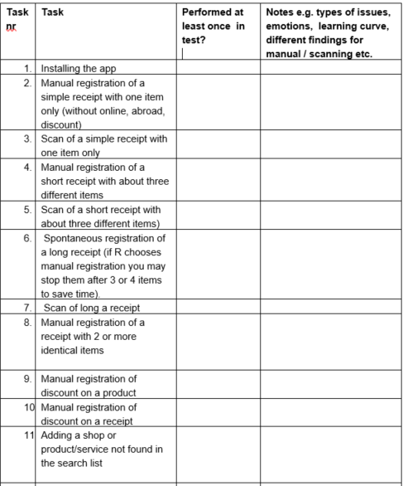
Part of task list used in test

Slide 7
Test design
Full observation group:
Install the app in the lab
Spontaneous use of app with some receipts of own expenses
Evaluate perception based on spontaneous use
Scripted use (give specific tasks e.g. change an entry, looks at overview)
Evaluation of communication materials and data collection strategy
Retrospective interview group:
- Install the app at home
- Use app for several days
- Report experiences during use an on reporting template with screenshots
- Evaluate use and entered data during interview in the lab
- Scripted use in lab
- Evaluation of data collection strategy in lab

Slide 8
Main results app (1/3)
Respondents are positive about the app. Prefer app-data collection over other modes because…
You always have your phone with you, can easily update expenses on the go
Ease of entering data with taking a picture of a receipt
Interesting overview of expenses
For group who used app for a week in test round 2: response burden acceptable (n=8)
Communication of response task is crucial
Several respondents saw the app as mainly/just a tool for themselves, not as a data collection instrument which led to suboptimal data quality (“I don’t care if I bought something online or not, so I do not bother to indicate that”)
Instructions on what and how to report very important for data quality: both content and usability of how instructions are presented
Walk through tutorial added for test round 2, some UX improvement needed for this

Slide 9
Main results app 2/3
Quality of content search lists important for usability and for ensuring professional appearance of app
Some doubt about effect of using search lists for products: some indications that open text field may provide better data (e.g. respondents quickly select an option that seems OK but is not an exact match, do not take the effort to add a product), but this may also result in higher burden. More research needed!
Respondents would like/expect more functionality from “scanning” receipts
Instant feedback needed to assure quality of pictures
Logic of manual entry did not work well in test round 1, improved for test round 2
Logic of entering discount not clear, changes as tested in round 2 still not clear

Slide 10
Main results app 3/3
Consent and data linkage
Respondents differ as to willingness to share various types of data (roughly: “sure, I don’t mind” , “maybe, if I understand why this is needed and trust that this is done in a safe way”, “no never!”)
Adding data linkage from for example bank accounts may complicate usability! As using the app is considered not so burdensome, the benefits of adding data linkage to the app may not outweigh the costs (e.g. confusing about where entries come from, concern about safety)
Many other technical and usability findings, e.g. issues with phones set to using a large letter, warnings when deleting /editing, idea to add picture of app to improve ease of finding app

Slide 11
Main results testing methodology
Mix of observing and retrospective works well; both methods provide valuable additional results
Important to evaluate use after several days! Testing only in lab will not give a realistic picture (e.g. understanding that a day must be completed only possible at second day of use)
Important to make task list to make sure all relevant (sub) tasks are evaluated
Analysing usability issues is very time intensive, may require watching fragments several times

Slide 12
Discount and rebate
It seems that including discounts and/or rebates is a complex feature, both for manual entry and receipt scan entry
Possible solution: List all possible ways of discounts and rebates within countries and across countries and let UI ask for type before data entry.
SUGGESTIONS?

Slide 13
For more information on testing
@HBS deliverables:
Test plan, WP3, Giesen, D.
Test material round 1, WP3, Giesen, D., Theunissen, S., Nyholt, M., Vrabič-Kek, B., Zgonec, M., Järvensivu, M., Niemelä, A.
Test protocol round 2, WP3, Giesen, D., Theunissen, S., Nyholt, M., Vrabič-Kek, B., Zgonec, M., Järvensivu, M., Niemelä, A
Test reports round 1 + 2, WP3, Vrabič-Kek, B., Giesen, D., Järvensivu, M.
Test mock-ups for big data linkage consent, WP3, Giesen, D., Theunissen, S
Or contact d.giesen@cbs.nl or Brigita.Vrabic-Kek@gov.si

